Slide 1
Software Measurement
Measuring software indicators: metrics and methods
Jalote-2002,

Slide 2
Models
Empirical
Model
Numerical
Model
Measurement
Understanding/Refinement
Statistical/Math Analysis
Results (Empirical)
Results (Numerical)
Interpretation

Slide 3
Basic Concepts
Project planning and tracking need measurement
Purpose = control and visibility
Metrics (Measures), quantified process attributes
  e.g. size in LOC
Plan based on organizational model and goals
  e.g. using GQM method
Continuous and including phase information
  e.g. defect tracking

Slide 4
Core Metrics
Management
  Work and progress
  Budget and cost
  Staffing and team dynamics
Quality
  Change and stability
  Modularity
  Rework
  MTBF

Slide 5
Metrics Characteristics
Meaningful to all people involved
Quantifiable correlation between process and business
Objective and clear
Displaying trends (extrapolation)
Natural by-product of process
Automation supported
Correlated

Slide 6
Frequently-Used Metrics
Size
  SLOC, FP, …
  Consider re-use and modification
  Separate definitions for different languages/system
  Compared to estimation (trend)
Personnel
  Number of staff
  Specify experienced, support, …
  Lower in “total” estimates results in increase in “experienced”

Slide 7
Frequently-Used Metrics
Volatility
  Number of changes in requirements and defects
  Includes developers’ understanding of requirements
  Change in requirements has to decrease and eventually freeze
Computer Resource Utilization
  CPU, memory, IO, …
Schedule
  Months/weeks of work
  Usual to fall behind initially
  Relate to actual cost

Slide 8
GQM Method
Goal-Question-Metric
Goal-oriented measurement
Based on Business and process model
  Business model provides the goals
  Process model provides the details and sub-goals
Goals
Q1, Q2 Q3, Q4
M₁, M₂, M₃
M₄, M₅, M₆

Slide 9
GQM Steps
1- Define business goals
  High quality product
  Customer satisfaction
  Service improvement
2- Provide the process model (made of entities)
  Inputs (resources, policies, …)
  Outputs (software, documents, …)
  Activities (analysis, design, …)
  Artefacts (knowledge, experience, meeting notes, …)

Slide 10
GQM Steps
3- Prepare general questions about entities (for each high-level goal)
  People: Trained? (related to “quality” goal)
  Reports: Signed off?
  Code: Size?
4- Group the related questions into “groups” (based on entity) and then “sub-goals” (based on objective)
  Group: Documents
  Sub-goal: Improved requirement analysis
  Question: Requirement document ready and clear for design?

Slide 11
GQM Steps
5- Find the entities under question and all the related attributes
  Entity: review meetings
  Attributes: # defects found
6- Formalized measurement goals
7- Quantifiable questions
  Metrics
8- Data elements

Slide 12
Measurement Plan
Metrics
Procedures
Media
Report
Collect
Goal Data
Validate

Slide 13
Measurement Plan
a name and definition for each unique metric;
the classification for each metric;
an association point in product development that identifies when and how data is to be collected;
definitions of the data collection forms;
the procedures for data reporting, collection,and validation;

Slide 14
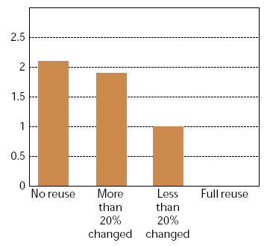
Analysis Plan
The last deliverable of MP is “analysis plan”
AP describes how to analyze measured data into presentation formats like charts.
  fault density for
  the reuse categories.
  bars are faults/KSLOC

